Slide 1
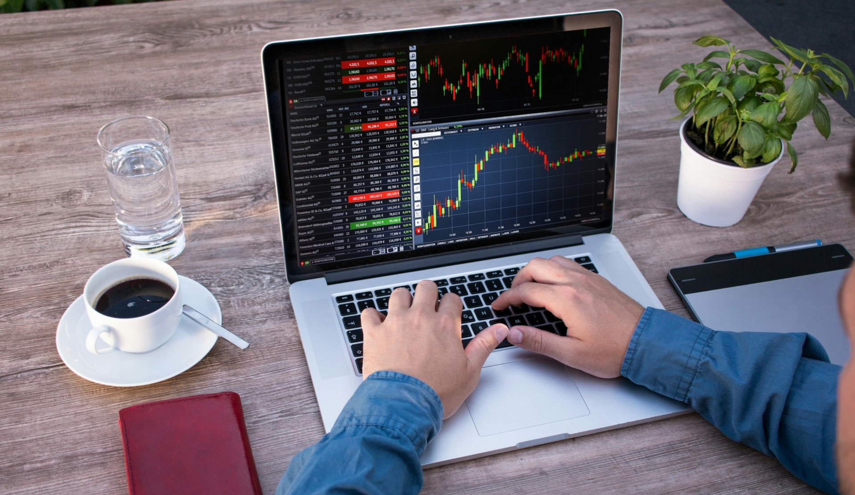
DATA PROGRAMMING FINAL PROJECT STOCK DATA ANALYSIS
Presented BY
Riby FRANCIS
SANISH BABU
BENNY BIJU
Anagha Seby

Slide 2
Project Description
Project Description
The goal of this project is to create a sophisticated stock analysis application using the Flask and Django frameworks within the PyCharm integrated development environment.
This application will provide users with comprehensive insights into stock market data, allowing them to make informed investment decisions.
The project will involve integrating various data sources, implementing advanced analysis algorithms, and creating a user-friendly interface.
The result of this project will be a fully functional and feature-rich stock analysis application that empowers users with the tools and information needed to make informed investment decisions.
It will provide a comprehensive analysis of stock market data, including technical indicators, news sentiment, and portfolio management capabilities, all presented through a user-friendly interface.
This application will serve as a valuable resource for both beginner and experienced investors seeking to enhance their trading strategies.

Slide 3

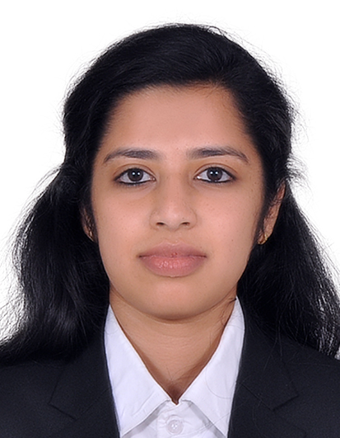
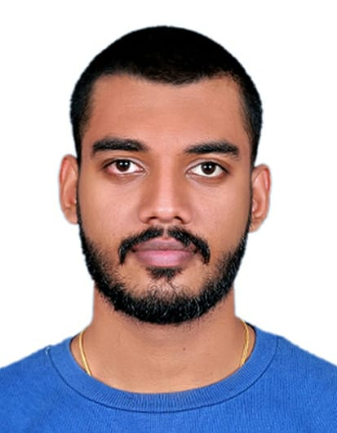
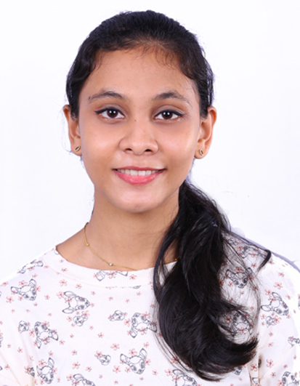
Meet our Team Members
Sanish Babu - 200544779
Riby Francis - 200550847
Benny Biju - 200557469
Anagha Seby - 200531538
Bachelor of Computer Application (BCA)
Currently Pursuing Post Graduation in Big Data Analytics
Bachelor of Technology (Btech) in Computer Science and Engineering with Honours Specialization in Artificial Intelligence and Machine Learning
Currently Pursuing Post Graduation in Big Data Analytics
Bachelor in Mathematics, Statistics, and Physics
Currently Pursuing Post Graduation in Big Data Analytics
Bachelor in Mathematics, Statistics, and Physics
Currently Pursuing Post Graduation in Big Data Analytics

Slide 4

The Stock Data Analysis Application is a cutting-edge software solution designed to empower investors, traders, and financial enthusiasts with comprehensive tools for analyzing stock market data.
Business Plan
This application will provide real-time and historical stock data, advanced technical indicators, sentiment analysis, and portfolio management features. The project aims to fill the gap in the market for a user-friendly, all-in-one platform that combines data analysis, visualization, and educational resources.
"The data extracted from the provided Rapid API link was utilized to access Latest Stock Price API Documentation (suneetk92) | RapidAPI. This API was instrumental in extracting data using Python and MongoDB codes, which were integrated and executed within the PyCharm development environment."

Slide 5





Tools Used
Python serves as the primary programming language, playing a pivotal role in backend coding, crafting API requests, establishing connections with MongoDB, and facilitating the execution of the Flask web application.
MongoDB, a versatile NoSQL database, is harnessed to securely store the data that's retrieved from various sources.
HTML, or Hypertext Markup Language, lends its structure to the content of webpages, providing the foundation for their layout.
Javascript, a dynamic scripting language, becomes the bridge to integrate the powerful Google Charts library, empowering the creation of interactive and engaging visualizations on the webpage.
Google Charts, a JavaScript library revered for its prowess in crafting diverse data visualizations such as line charts, bar charts, pie charts, and more, becomes an integral component of the application.
PyCharm, a feature-rich integrated development environment, becomes the command center for scripting, writing, and executing Python codes, providing a streamlined experience for developers.
The terminal, a command-line interface, assumes its role in managing Python scripts and the development server, effectively orchestrating the application's functioning.

Slide 6
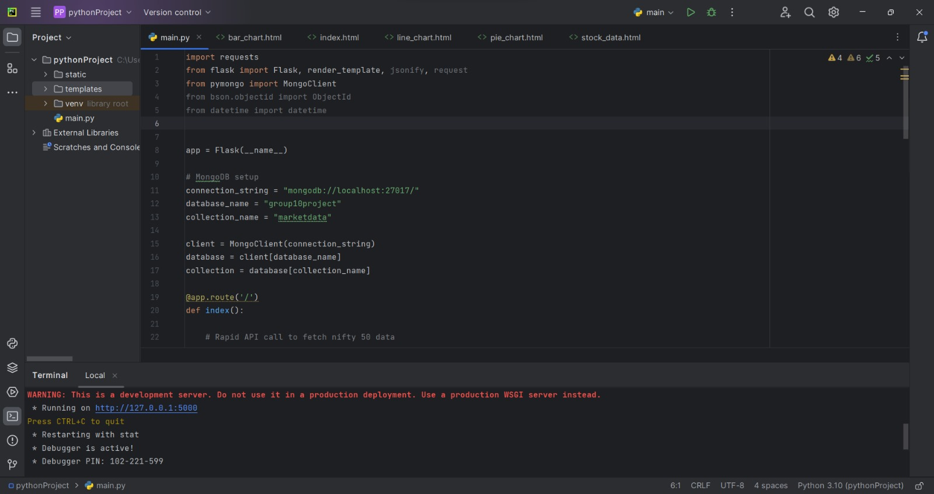
Code: main.py

Slide 7
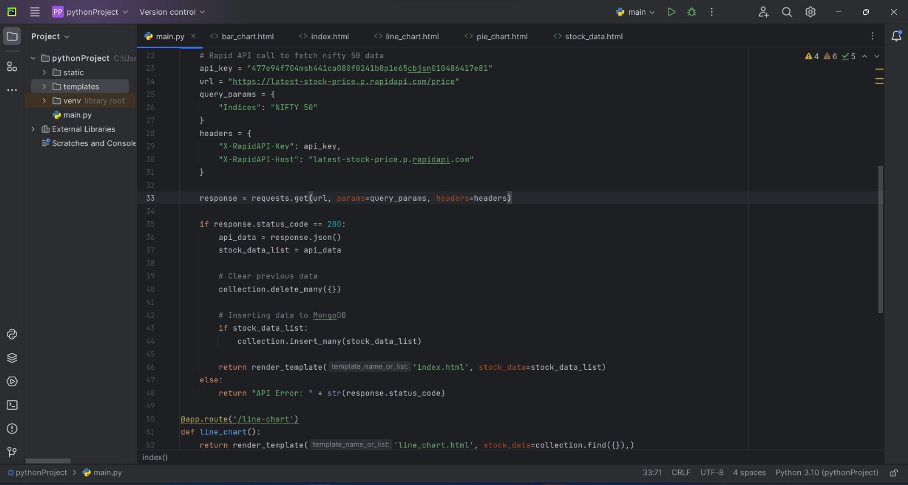
main.py…..

Slide 8
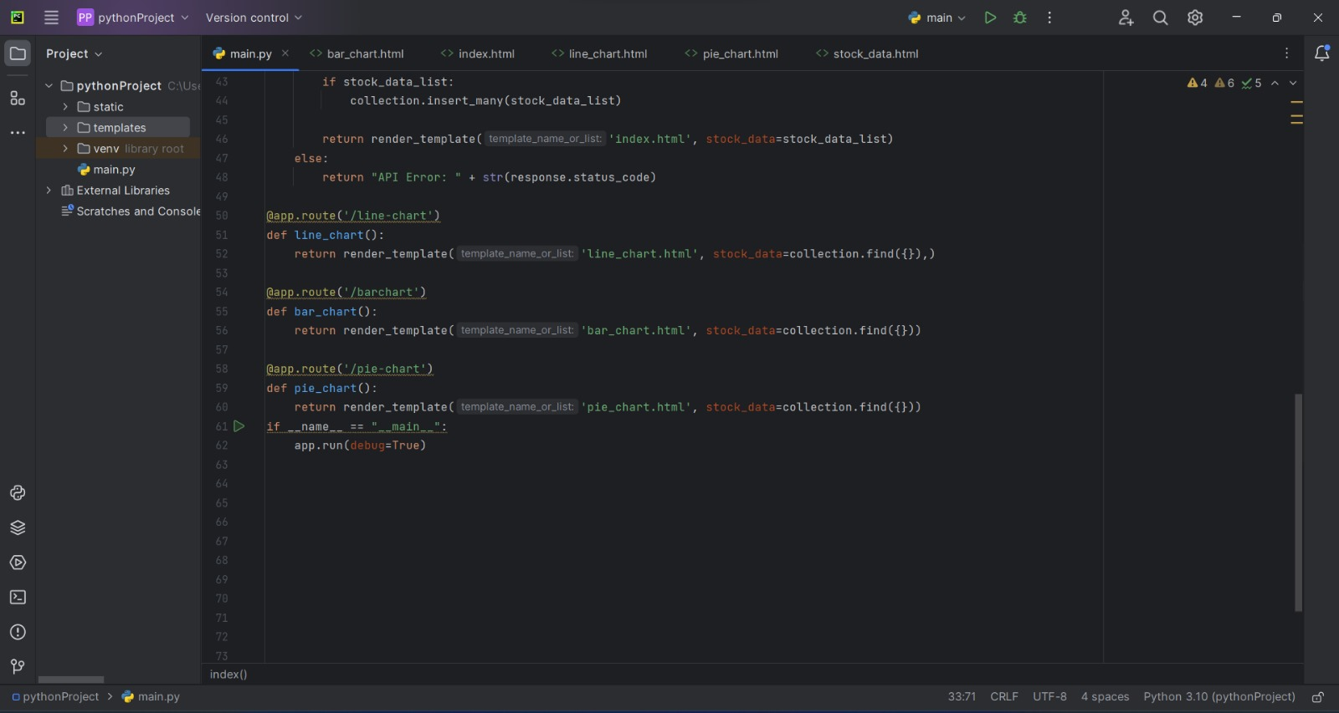
main.py…..

Slide 9
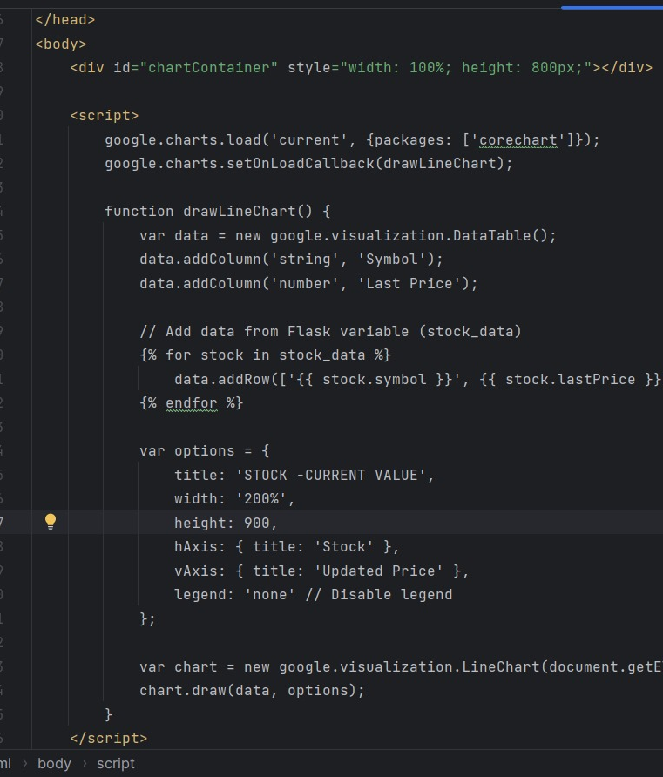
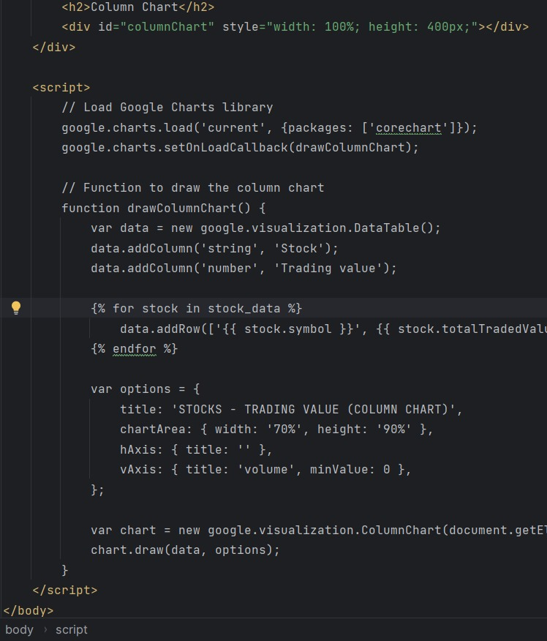
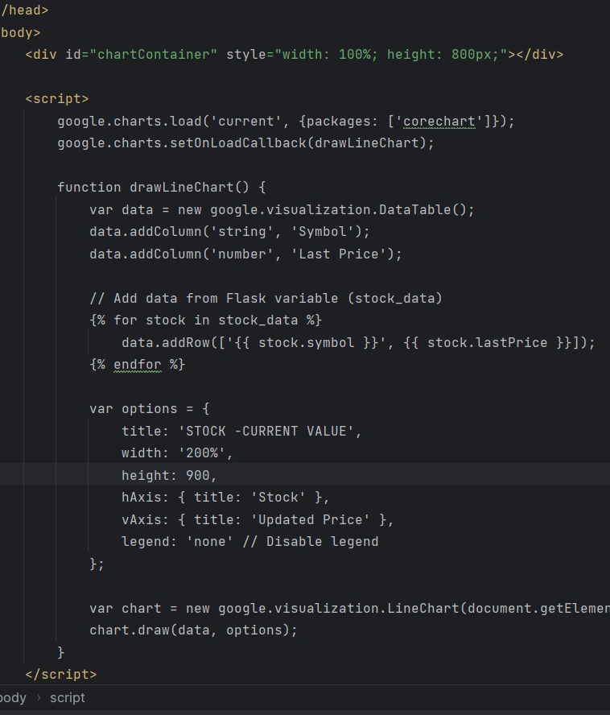
Graphical Codes
Column Chart
Line Chart
Histogram

Slide 10
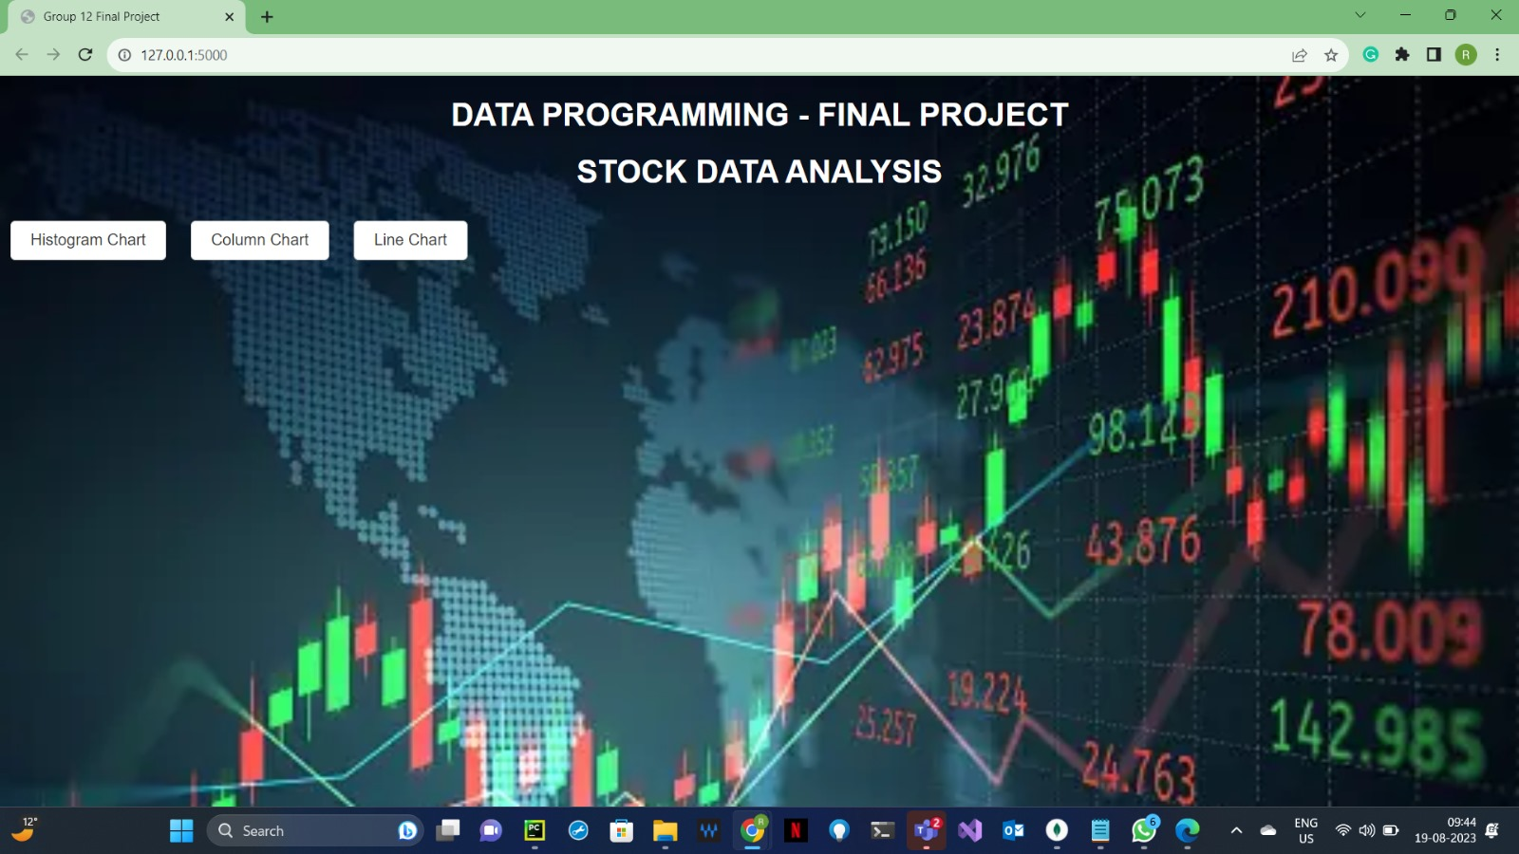
Home Page
Output Screenshot

Slide 11
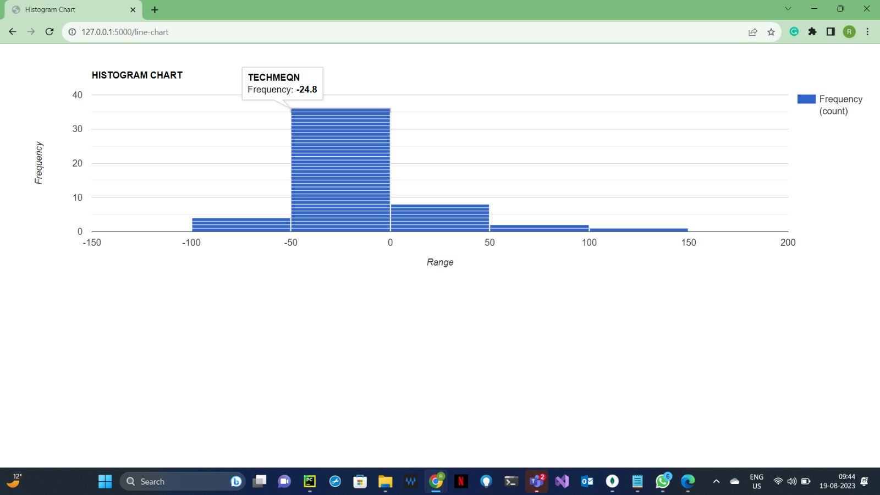
Histogram
Output Screenshot

Slide 12
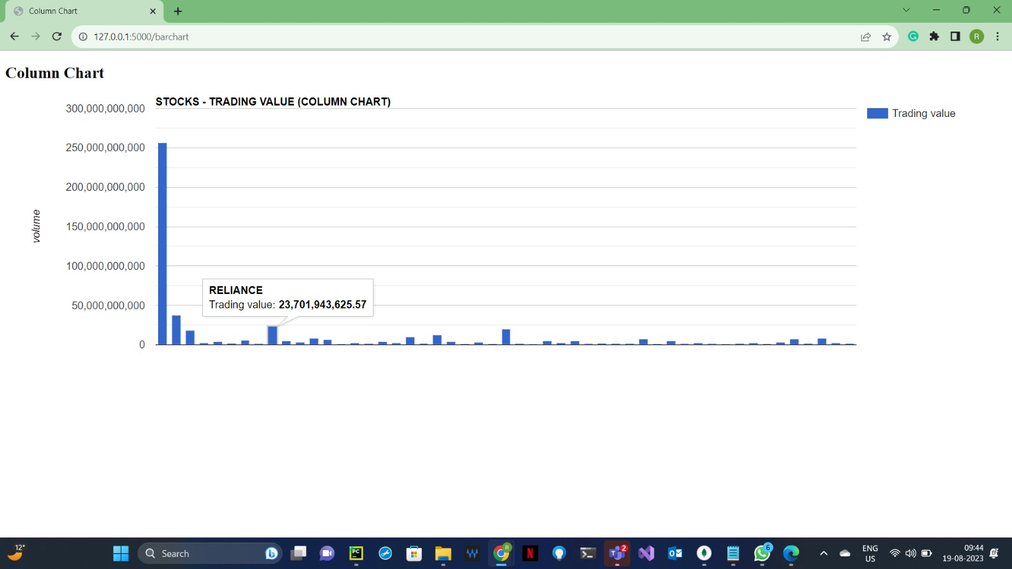
Column Chart
Output Screenshot

Slide 13
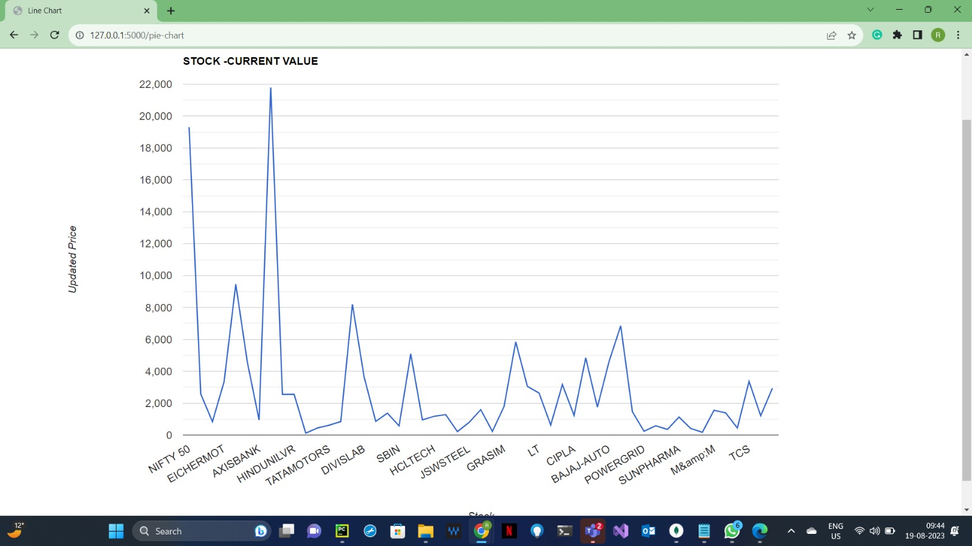
Line Chart
Output Screenshot

Slide 14
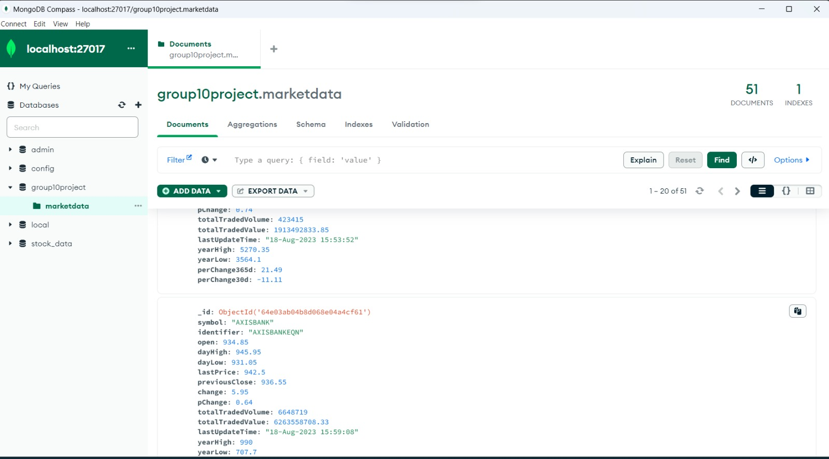
Database

Slide 15
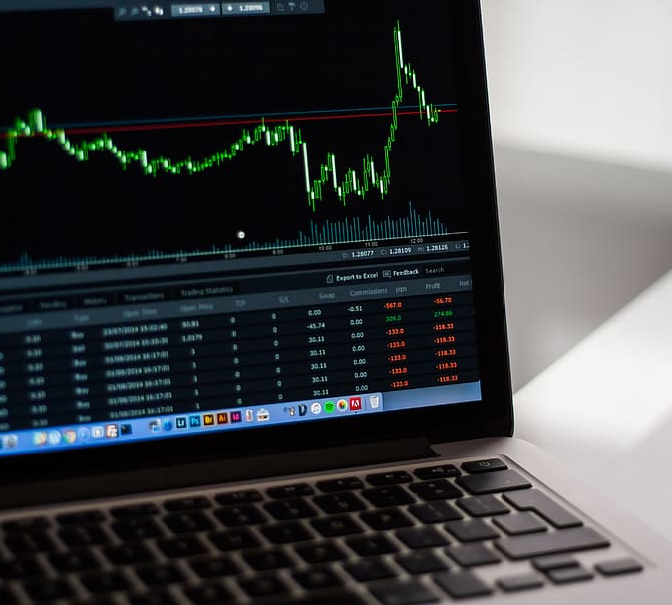
Thank you !
Presented By:
Riby Francis – 200550847
Sanish Babu – 200544779
Benny Biju – 200557489
Anagha Seby – 200531538

